Slide 1

STABILITY AND STABILIZATION OF NETWORKED LOAD FREQUENCY CONTROL SYSTEMS INTEGRATED WITH ELECTRIC VEHICLE AGGREGATORS.
Presented By:
Sharini Rithigaa B S (17CE153).
Gokulnath M (17EE111).
Kalavagunta Vamshi (17EE118).
Kalla Anil Sai Kumar (17EE119).
Under the guidance of, Dr. K.Ramakrishnan, M.E., Ph.D.,
Associate Professor,
Department of EEE.

Slide 2
INTRODUCTION:
Whenever there is heavy power demand or power shortage the frequency of the voltage between the tie lines connecting Electric vehicle aggregator and smart grid reduces.
This reduction in frequency is sensed through sensor and the information is sent to information center by PI controller.
According to the level of reduction in frequency, the PI controller decides how much input of power to be extracted from the Electric Vehicle Aggregator.
Here, the Electric Vehicle Aggregator acts as source of power to compensate the demand of power along with the Smart Grid.

Slide 3
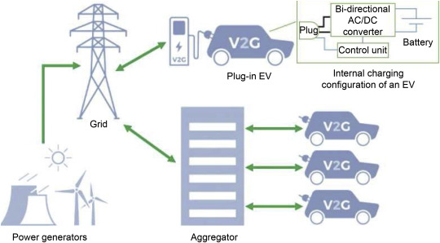
Fig 1. Integration of Electric Vehicle Aggregator to grid.

Slide 4
LITERATURE SURVEY:
This project deals with computation of communication time delays on stability regions and stability delay margins of the PI controller between the Electric Vehicle Aggregator and the smart grid of a single area load frequency control(LFC) system.
A graphical method of characterizing stability boundary locus is implemented.
For a given time delay, the method computes all the stability gains of PI controller, which constitutes a stability regions in parameters of space of PI controller.
Later a frequency domain exact method is used to calculate stability delay margins for various values of PI controller gains.
The complete analysis is made in order to pass the information of error in the system within the stability margin delay to bring the system to equilibrium point.

Slide 5
OBJECTIVES OF PROJECT:
To access the impact of integrating electrical vehicle aggregator on stability of single area load frequency control system.
The integration of geographically dispersed electric vehicle aggregator through communication network introduces time delay in closed loop control system.
The presence of time delay in feedback loop of the closed loop load frequency control system affects performance and stability of the system.
In this presentation, a methodology is presented to assess the maximum allowable bound of time delay within which the networked load frequency control system stays stable.

Slide 6
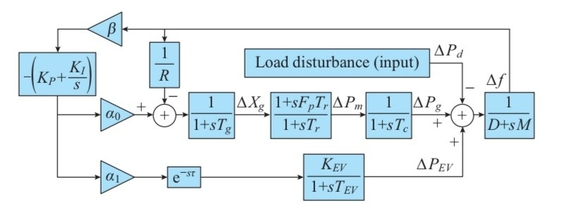
LFC SYSTEM MODEL WITH EV AGGREGATOR:
Fig. 1. System model of single-area LFC with EV aggregator.

Slide 7
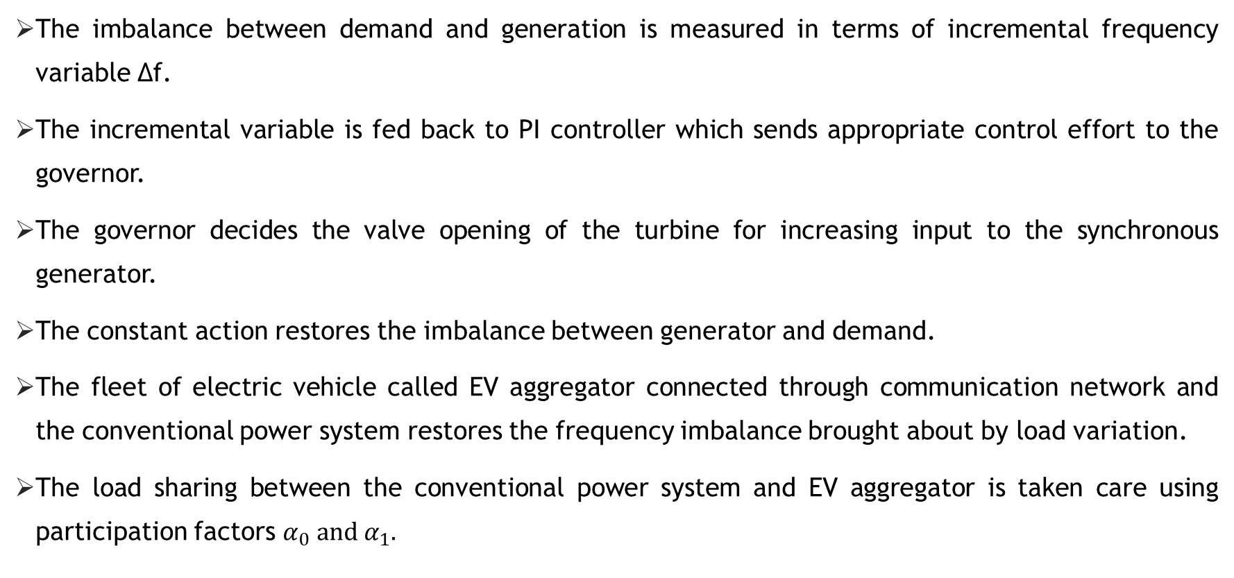
SYSTEM DESCRIPTION:
The imbalance between demand and generation is measured in terms of incremental frequency variable ∆f.
The incremental variable is fed back to PI controller which sends appropriate control effort to the governor.
The governor decides the valve opening of the turbine for increasing input to the synchronous generator.
The constant action restores the imbalance between generator and demand.
The fleet of electric vehicle called EV aggregator connected through communication network and the conventional power system restores the frequency imbalance brought about by load variation.
The load sharing between the conventional power system and EV aggregator is taken care using participation factors $α_{0} and α_{1}.$

Slide 8
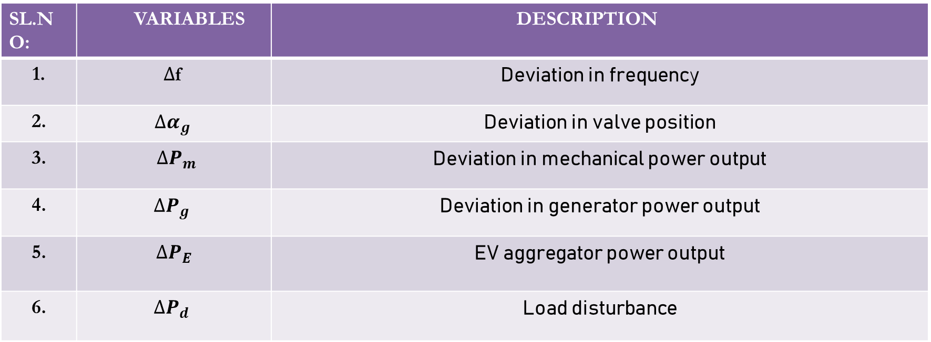
DESCRIPTION OF VARIABLES :
SL.NO: | VARIABLES | DESCRIPTION
1. | $∆$f | Deviation in frequency
2. | $$∆α_{g}$$ | Deviation in valve position
3. | $$∆P_{m}$$ | Deviation in mechanical power output
4. | $$∆P_{g}$$ | Deviation in generator power output
5. | $$∆P_{E}$$ | EV aggregator power output
6. | $$∆P_{d}$$ | Load disturbance

Slide 9
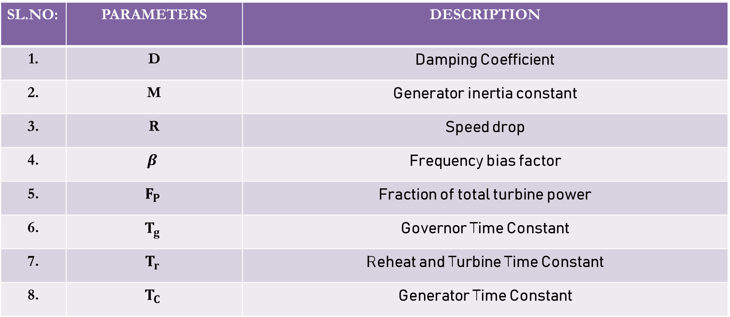
DESCRIPTION OF PARAMETERS:
SL.NO: | PARAMETERS | DESCRIPTION
1. | D | Damping Coefficient
2. | M | Generator inertia constant
3. | R | Speed drop
4. | $$β$$ | Frequency bias factor
5. | $$F_{P}$$ | Fraction of total turbine power
6. | $$T_{g}$$ | Governor Time Constant
7. | $$T_{r}$$ | Reheat and Turbine Time Constant
8. | $$T_{C}$$ | Generator Time Constant

Slide 10
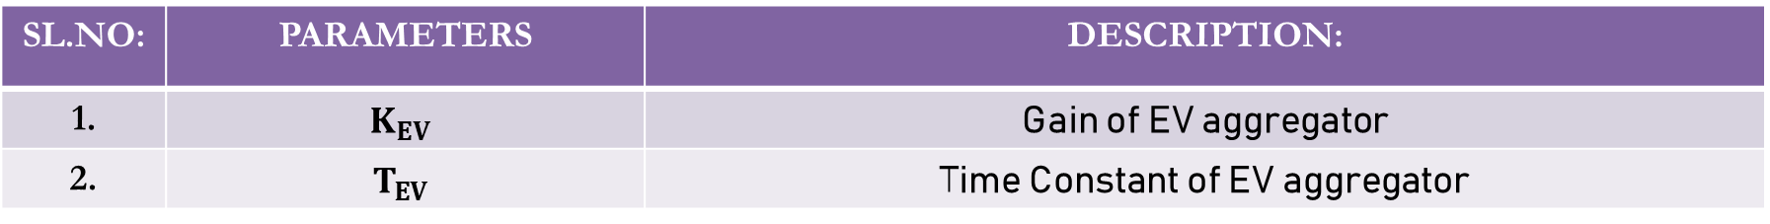
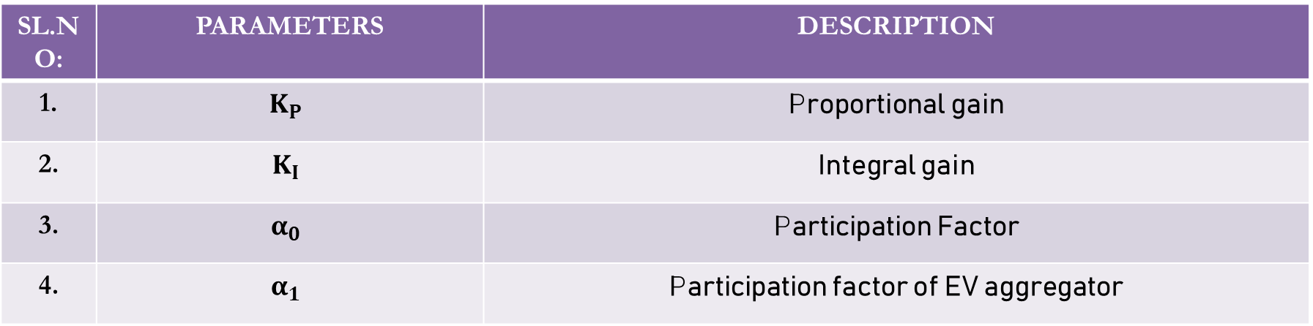
CONTROLLER PARAMETERS AND PARTICIPATION FACTORS:
SL.NO: | PARAMETERS | DESCRIPTION
1. | $$K_{P}$$ | Proportional gain
2. | $$K_{I}$$ | Integral gain
3. | $$α_{0}$$ | Participation Factor
4. | $$α_{1}$$ | Participation factor of EV aggregator
PARAMETERS OF ELCTRIC VEHICLE AGGREGATOR:
SL.NO: | PARAMETERS | DESCRIPTION:
1. | $$K_{EV}$$ | Gain of EV aggregator
2. | $$T_{EV}$$ | Time Constant of EV aggregator
Communication Delay is given by e^{-sτ}

Slide 11
DELAY DEPENDANCY STABILITY:
The characteristic equation has delay term e^{-sτ} in it. Hence, system stability depends on time delay τ.
For a satisfactorily designed PI controller, with τ = 0, all the closed-loop poles are in the LHS of S plane.
With increase in network τ, a pair of complex conjugate poles exhibits a tendency to move towards jω axis.
When time delay τ equals a critical delay value called stable delay margin τ* the closed loop system has one pair of purely imaginary poles on jω axis. At this condition, the system is at the verge of instability.
The objective of the stability analysis to compute τ*, the maximum allowable delay bound that guarantees marginal stability.
For τ > τ*, the closed loop system becomes unstable.

Slide 12
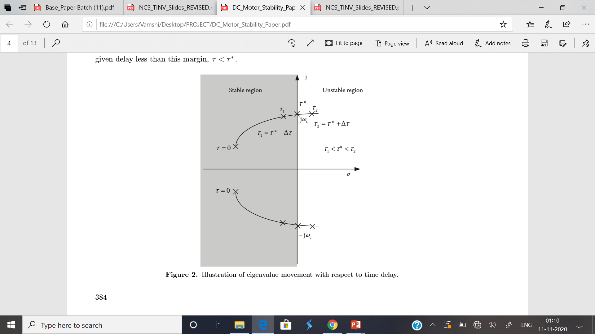
DELAY DEPENDANCY STABILITY:

Slide 13
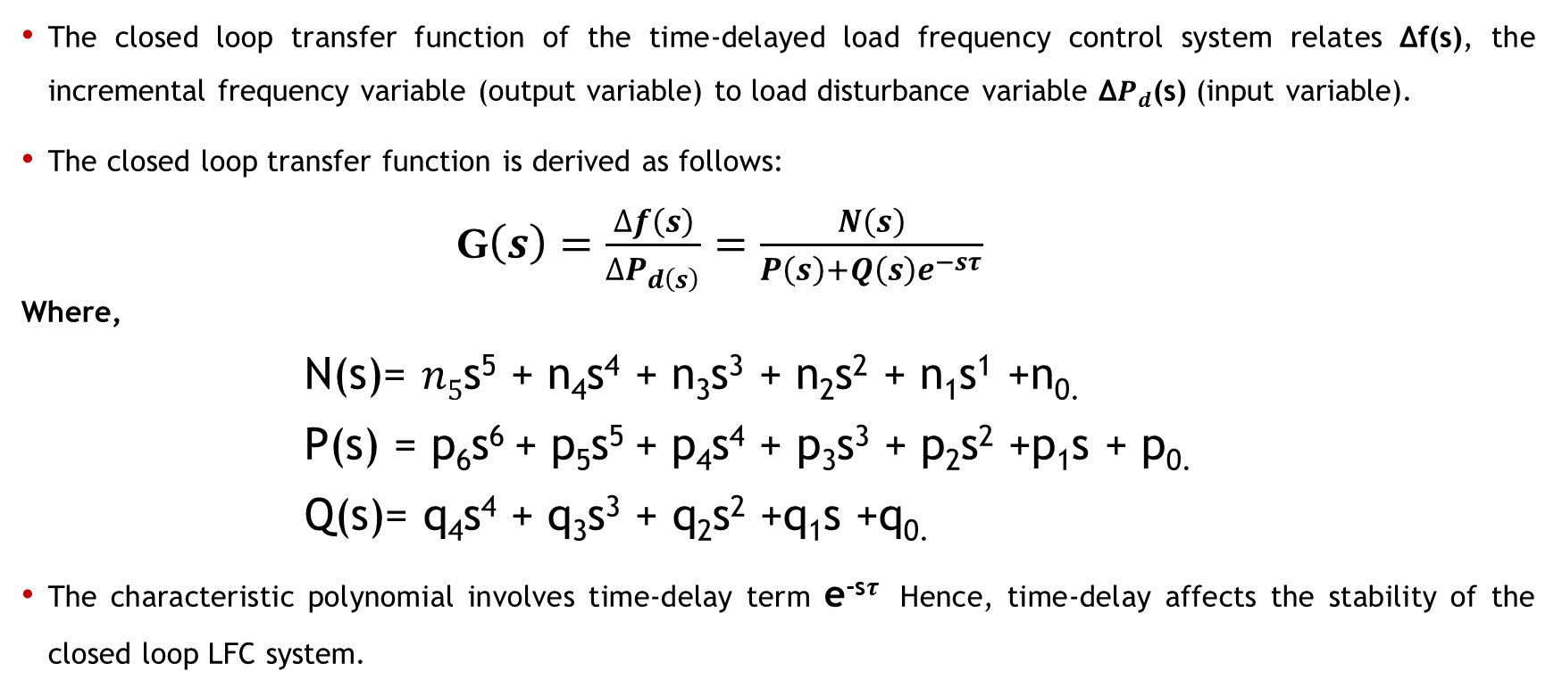
CLOSED LOOP TRANSFER FUNCTION:
The closed loop transfer function of the time-delayed load frequency control system relates Δf(s), the incremental frequency variable (output variable) to load disturbance variable Δ$P_{d}$(s) (input variable).
The closed loop transfer function is derived as follows:
G$\left(s\right)=\frac{∆f\left(s\right)}{∆P_{d\left(s\right)}}=\frac{N\left(s\right)}{P\left(s\right)+Q\left(s\right)e^{−sτ}}$
Where,
N(s)= $n5$s⁵ + n₄s⁴ + n₃s³ + n₂s² + n₁s¹ +n_{0.}
P(s) = p₆s⁶ + p₅s⁵ + p₄s⁴ + p₃s³ + p₂s² +p₁s + p_{0.}
Q(s)= q₄s⁴ + q₃s³ + q₂s² +q₁s +q_{0.}
The characteristic polynomial involves time-delay term e^{-s}$τ$ Hence, time-delay affects the stability of the closed loop LFC system.

Slide 14
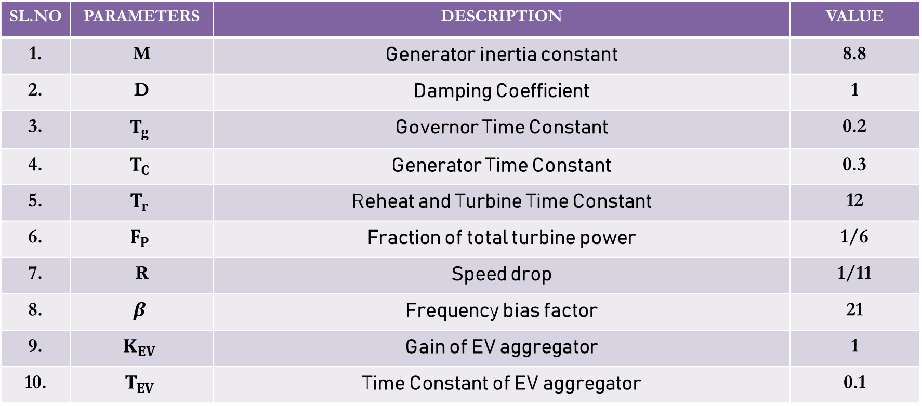
BENCHMARK SYSTEM PARAMETERS:
SL.NO | PARAMETERS | DESCRIPTION | VALUE
1. | M | Generator inertia constant | 8.8
2. | D | Damping Coefficient | 1
3. | $$T_{g}$$ | Governor Time Constant | 0.2
4. | $$T_{C}$$ | Generator Time Constant | 0.3
5. | $$T_{r}$$ | Reheat and Turbine Time Constant | 12
6. | $$F_{P}$$ | Fraction of total turbine power | 1/6
7. | R | Speed drop | 1/11
8. | $$β$$ | Frequency bias factor | 21
9. | $$K_{EV}$$ | Gain of EV aggregator | 1
10. | $$T_{EV}$$ | Time Constant of EV aggregator | 0.1

Slide 15
MATLAB OUTPUT :
$τ^{∗}$ - STABILITY DELAY MARGIN (s)
K_{p} | K_{I}=0.2 | K_{I}=0.4 | K_{I}=0.6 | K_{I}=0.8 | K_{I}=1.0
0 | 1.7866 | 0.4231 | 0.0859 | -0.0615 | -0.1417
0.1 | 2.7421 | 0.8271 | 0.3496 | 0.1340 | 0.0134
0.2 | 3.5861 | 1.2002 | 0.6018 | 0.3242 | 0.1656
0.3 | 4.2522 | 1.5214 | 0.8327 | 0.5034 | 0.3115
0.4 | 4.6970 | 1.7773 | 1.0346 | 0.6669 | 0.4477
0.5 | 4.8537 | 1.9635 | 1.2023 | 0.8108 | 0.5717
0.6 | 4.6817 | 2.0829 | 1.3339 | 0.9327 | 0.6812
0.7 | 4.3135 | 2.1433 | 1.4300 | 1.0317 | 0.7751
0.8 | 3.9050 | 2.1545 | 1.4932 | 1.1080 | 0.8527
0.9 | 3.5197 | 2.1273 | 1.5275 | 1.1628 | 0.9142
1.0 | 3.1740 | 2.0715 | 1.5372 | 1.1982 | 0.9606

Slide 16
COMPUTATION OF STABILITY DELAY MARGINS:
In last phase, for various values of the proportional gain constant K_{p} and integral gain constant K_{I}, the stability time delay margin was validated while keeping K_{p} and K_{I} values as constant in each individual case(for different sets of K_{p} and K_{I} values).
In this phase, by keeping time delay as constant, and for various values of time delay, we determine the values of K_{p} and K_{I} at which the system lies stable.
Also, the impact of EV aggregator participation factor α₁ and the communication time delay τ on the stability region is investigated.

Slide 17
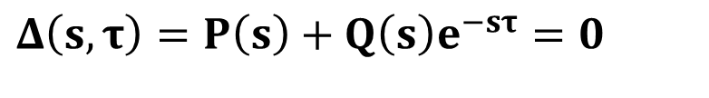
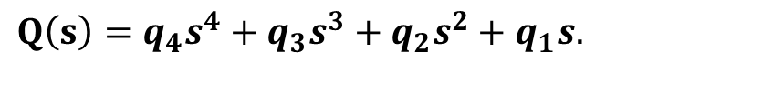
COMPUTATION OF STABILITY REGIONS:
For stability analysis, the characteristic equation given below of LFC system with time delay is required.
$$Δ\left(s,τ\right)=P\left(s\right)+Q\left(s\right)e^{−sτ}=0$$
(1)
Where,
$$P\left(s\right)=p_{6}s^{6}+p_{5}s^{5}+p_{4}s^{4}+p_{3}s^{3}+p_{2}s^{2}+p_{1}s.$$
$$Q\left(s\right)=q_{4}s^{4}+q_{3}s^{3}+q_{2}s^{2}+q_{1}s.$$

Slide 18
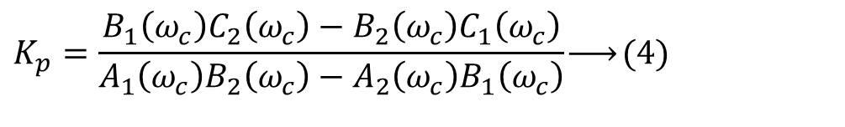
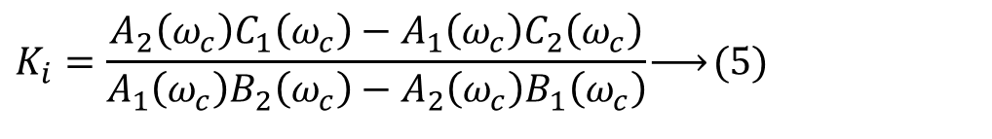
COMPUTATION OF STABILITY REGIONS:
On solving, We get,
$$K_{p}=\frac{B_{1}\left(ω_{c}\right)C_{2}\left(ω_{c}\right)−B_{2}\left(ω_{c}\right)C_{1}\left(ω_{c}\right)}{A_{1}\left(ω_{c}\right)B_{2}\left(ω_{c}\right)−A_{2}\left(ω_{c}\right)B_{1}\left(ω_{c}\right)}\underset{→}{ }(4)$$
$$K$$
$$K_{i}=\frac{A_{2}\left(ω_{c}\right)C_{1}\left(ω_{c}\right)−A_{1}\left(ω_{c}\right)C_{2}\left(ω_{c}\right)}{A_{1}\left(ω_{c}\right)B_{2}\left(ω_{c}\right)−A_{2}\left(ω_{c}\right)B_{1}\left(ω_{c}\right)}\underset{→}{ }(5)$$
Where, A1,B1,C1,A2,B2,C2 are coefficients.

Slide 19
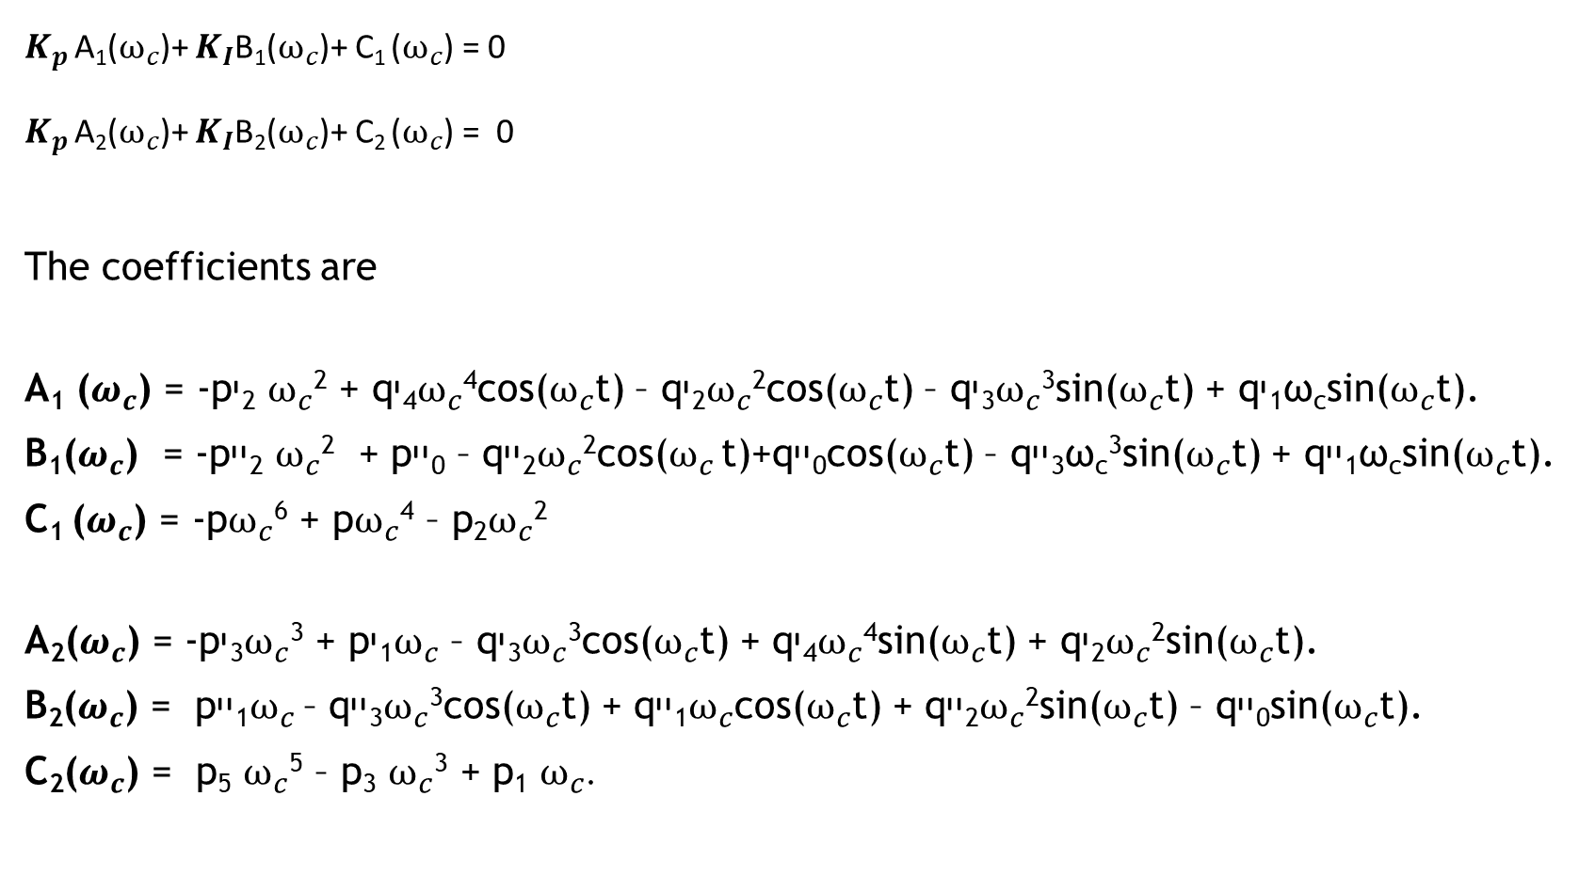
$K_{p}$A₁($ω_{c}$)+ $K_{I}$B₁($ω_{c}$)+ C₁ ($ω_{c}$) = 0
$K_{p}$A₂($ω_{c}$)+ $K_{I}$B₂($ω_{c}$)+ C₂ ($ω_{c}$) = 0
The coefficients are
A₁ ($ω_{c}$) = -pי₂$ω_{c}$² + qי₄$ω_{c}$⁴cos($ω_{c}$t) – qי₂$ω_{c}$²cos($ω_{c}$t) – qי₃$ω_{c}$³sin($ω_{c}$t) + qי₁ω_{c}sin($ω_{c}$t).
B₁($ω_{c}$) = -pיי₂$ω_{c}$² + pיי₀ – qיי₂$ω_{c}$²cos($ω_{c}$t)+qיי₀cos($ω_{c}$t) – qיי₃ω_{c}³sin($ω_{c}$t) + qיי₁ω_{c}sin($ω_{c}$t).
C₁ ($ω_{c}$) = -p$ω_{c}$⁶ + p$ω_{c}$⁴ – p₂$ω_{c}$²
A₂($ω_{c}$) = -pי₃$ω_{c}$³ + pי₁$ω_{c}$ – qי₃$ω_{c}$³cos($ω_{c}$t) + qי₄$ω_{c}$⁴sin($ω_{c}$t) + qי₂$ω_{c}$²sin($ω_{c}$t).
B₂($ω_{c}$) = pיי₁$ω_{c}$– qיי₃$ω_{c}$³cos($ω_{c}$t) + qיי₁$ω_{c}$cos($ω_{c}$t) + qיי₂$ω_{c}$²sin($ω_{c}$t) – qיי₀sin($ω_{c}$t).
C₂($ω_{c}$) = p₅$ω_{c}$⁵ – p₃$ω_{c}$³ + p₁$ω_{c}$.

Slide 20
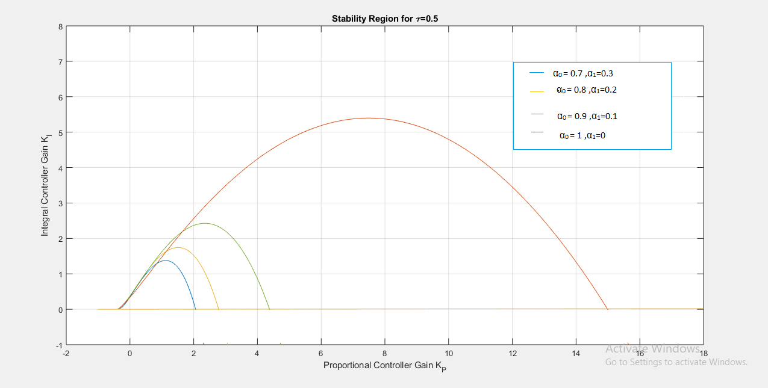
STABILITY REGION CURVE FOR TIME DELAY=0.5s FOR VARIOUS PARTICIPATION FACTORS:
Blue- α₀=0.7, α₁=0.3
Orange- α₀=0.8, α₁=0.2
Green- α₀=0.9, α₁=0.1
Brown- α₀=1.0, α₁=0

Slide 21
VALUES OF KP AND KI FOR SYSTEM STABILITY(For time delay=0.5s):
For system to be stable: The values of K_{p} and K_{I} should lie within the curve boundary for that participation factors.
Example: For α₁=0.3 and α₀=0.7 the values are K_{p} =1 and K_{I} =0.5
For system to be unstable: The values of K_{p} and K_{I} should lie anywhere out of curve boundary for that particular participation factors.
Example: For α₁=0.3 and α₀=0.7, the values are K_{p} =3 and K_{I} =2
For system to be marginally stable: The values of K_{p} and K_{I} should lie on or near to the curve boundary for that particular participation factors.
Example: For α₁=0.3 and α₀=0.7, the values are K_{p} =1.8 and K_{I} =1.4

Slide 22
SIMULATION RESULTS: STABILITY ANALYSIS FOR VARIOUS COMMUNICATION DELAYS.

Slide 23
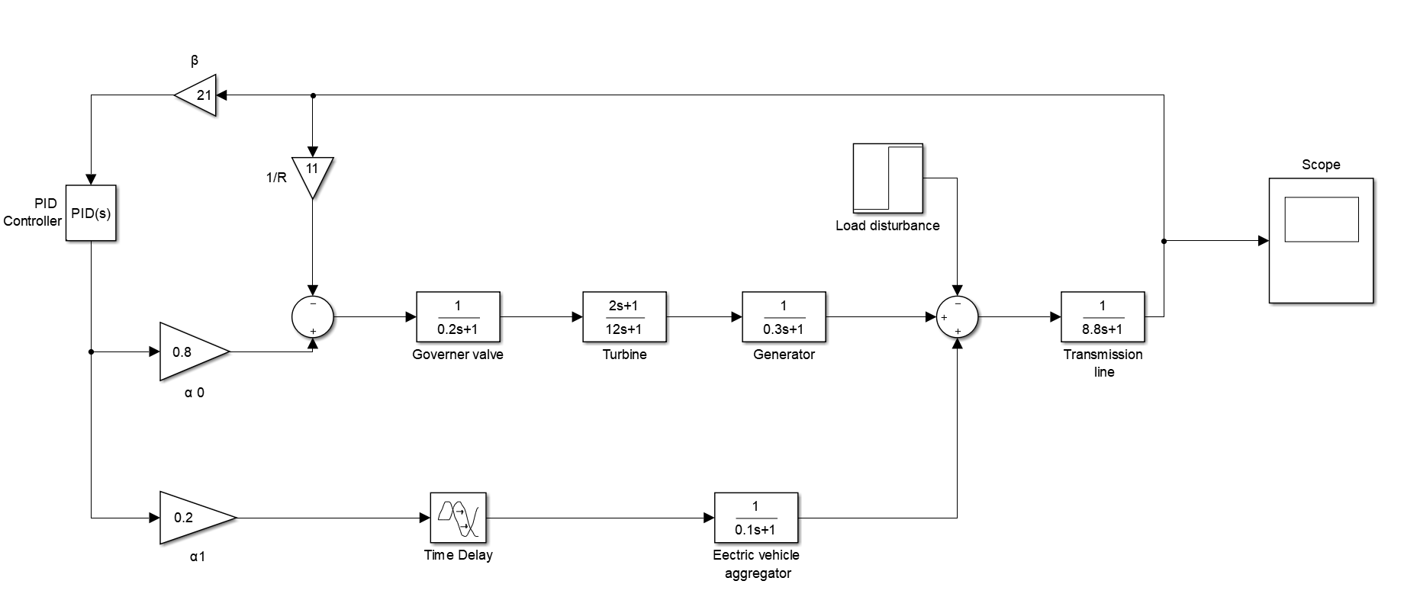
SIMULATION:
Fig.2 : System Model of Single Area LFC control system with EV aggregator.

Slide 24
MATLAB OUTPUT :
$τ^{∗}$ - STABILITY DELAY MARGIN (s)
K_{p} | K_{I}=0.2 | K_{I}=0.4 | K_{I}=0.6 | K_{I}=0.8 | K_{I}=1.0
0 | 1.7866 | 0.4231 | 0.0859 | -0.0615 | -0.1417
0.1 | 2.7421 | 0.8271 | 0.3496 | 0.1340 | 0.0134
0.2 | 3.5861 | 1.2002 | 0.6018 | 0.3242 | 0.1656
0.3 | 4.2522 | 1.5214 | 0.8327 | 0.5034 | 0.3115
0.4 | 4.6970 | 1.7773 | 1.0346 | 0.6669 | 0.4477
0.5 | 4.8537 | 1.9635 | 1.2023 | 0.8108 | 0.5717
0.6 | 4.6817 | 2.0829 | 1.3339 | 0.9327 | 0.6812
0.7 | 4.3135 | 2.1433 | 1.4300 | 1.0317 | 0.7751
0.8 | 3.9050 | 2.1545 | 1.4932 | 1.1080 | 0.8527
0.9 | 3.5197 | 2.1273 | 1.5275 | 1.1628 | 0.9142
1.0 | 3.1740 | 2.0715 | 1.5372 | 1.1982 | 0.9606

Slide 25
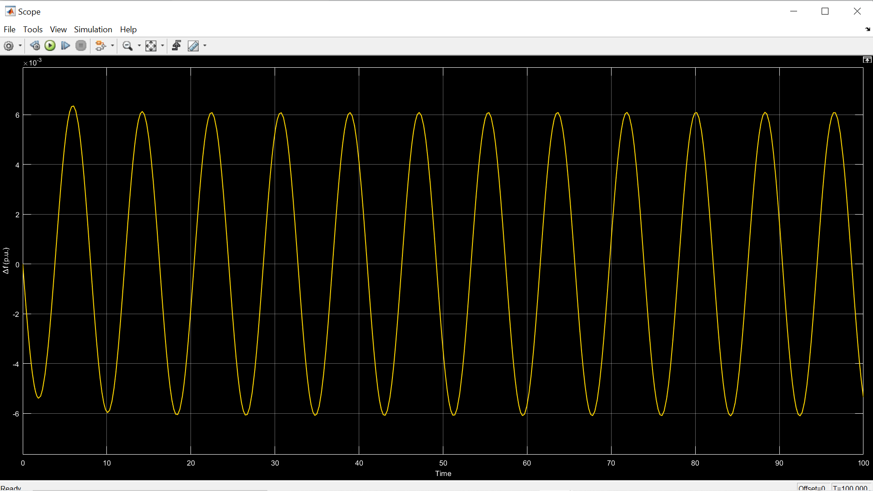
For K_{p}=0.2, K_{i} =0.6 and Communication Delay , τ*= 0.6018 sec (Marginal stable response)

Slide 26
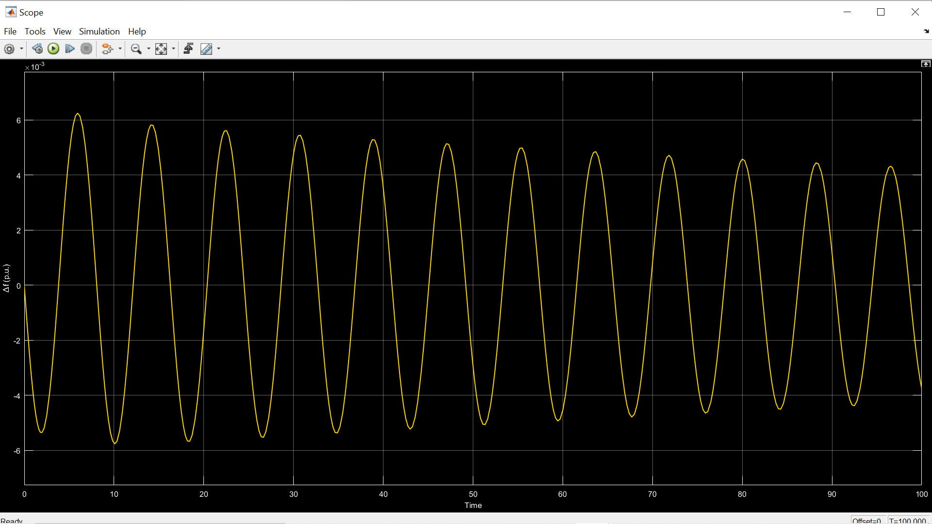
For K_{p}=0.2, K_{i} =0.6 and Communication Delay , τ*= 0.5156 sec (Stable response)

Slide 27
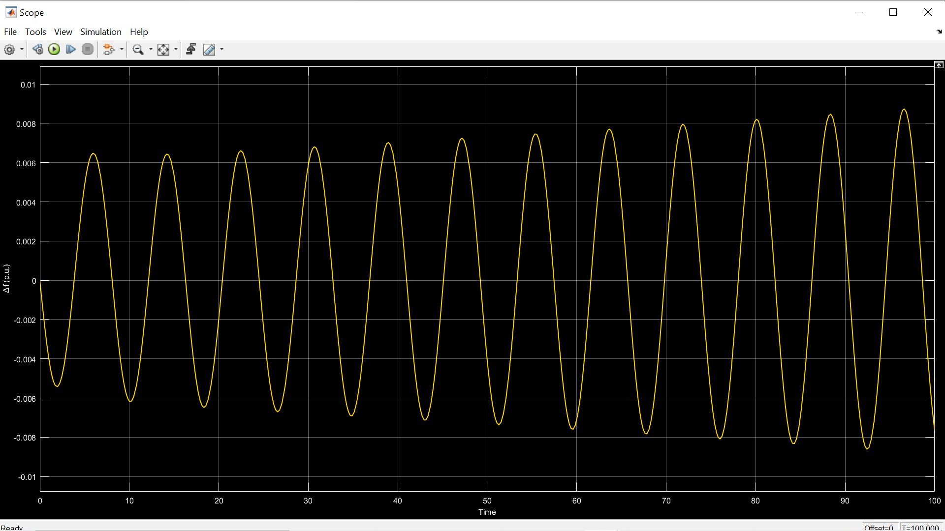
For K_{p}=0.2, K_{i} =0.6 and Communication Delay , τ*= 0.7125 sec (Unstable response)

Slide 28
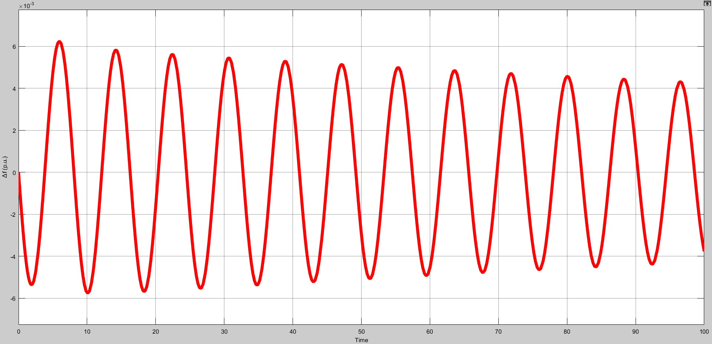
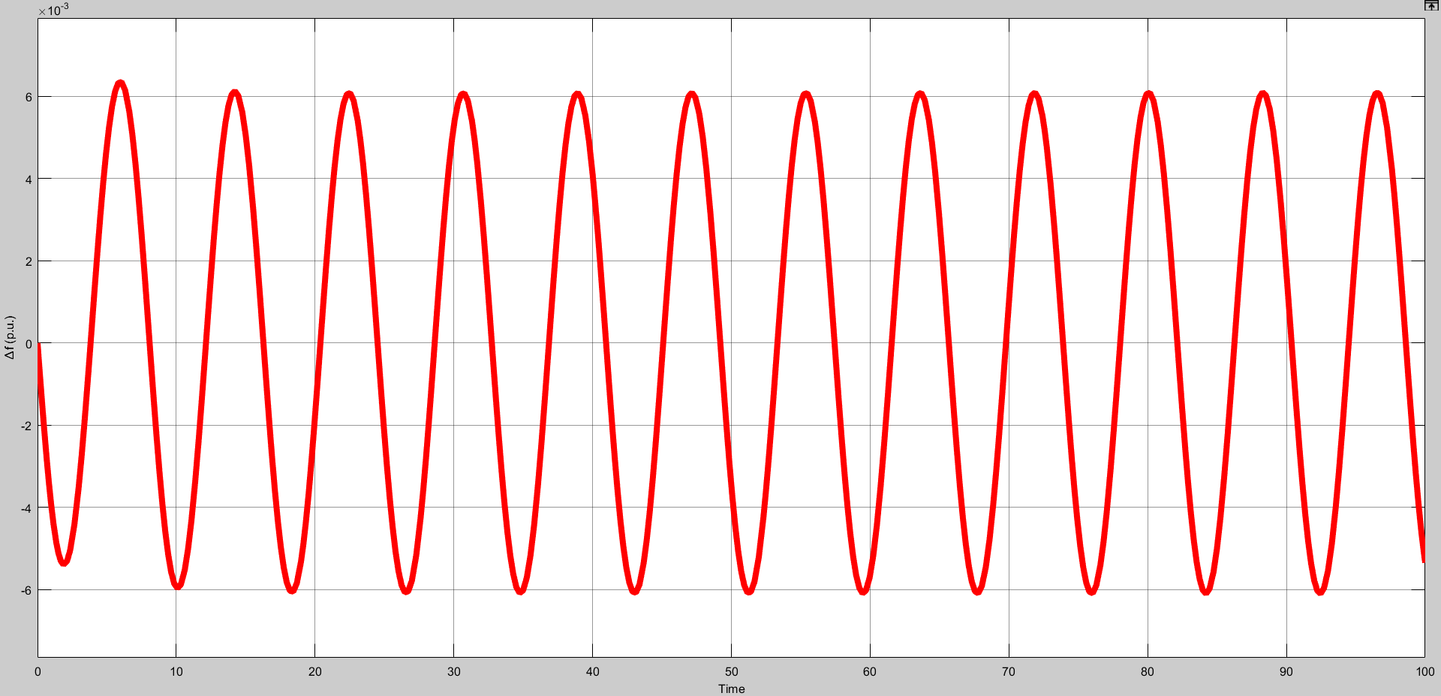
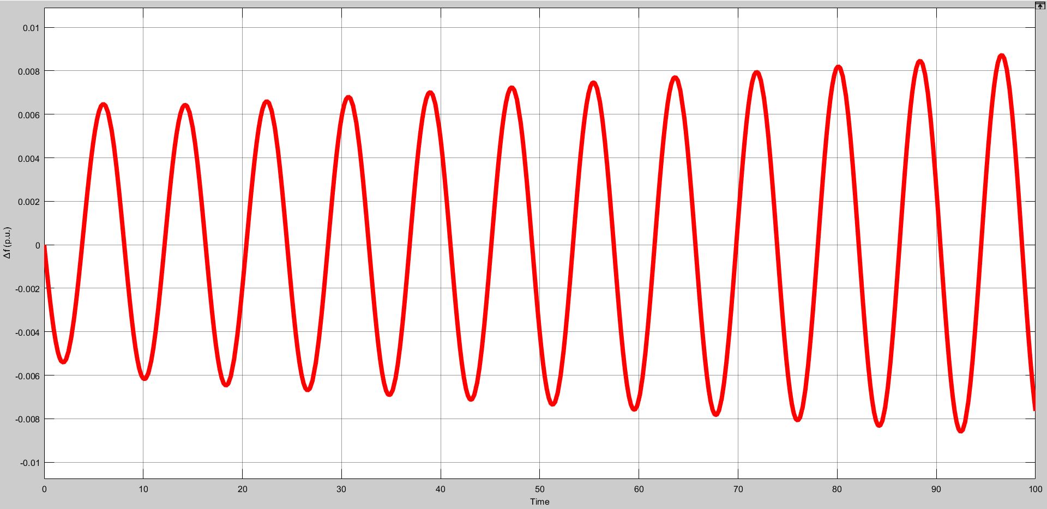
COMPARISON OF FREQUENCY RESPONSE OF LFC-EV SYSTEM FOR DIFFERENT TIME DELAYS: For K_{p}=0.1 , K_{i} =0.6.
τ*= 0.325 sec
(Stable response)
τ*= 0.3496 sec
(Marginal stable response)
τ*= 0.375 sec
(Unstable response)

Slide 29
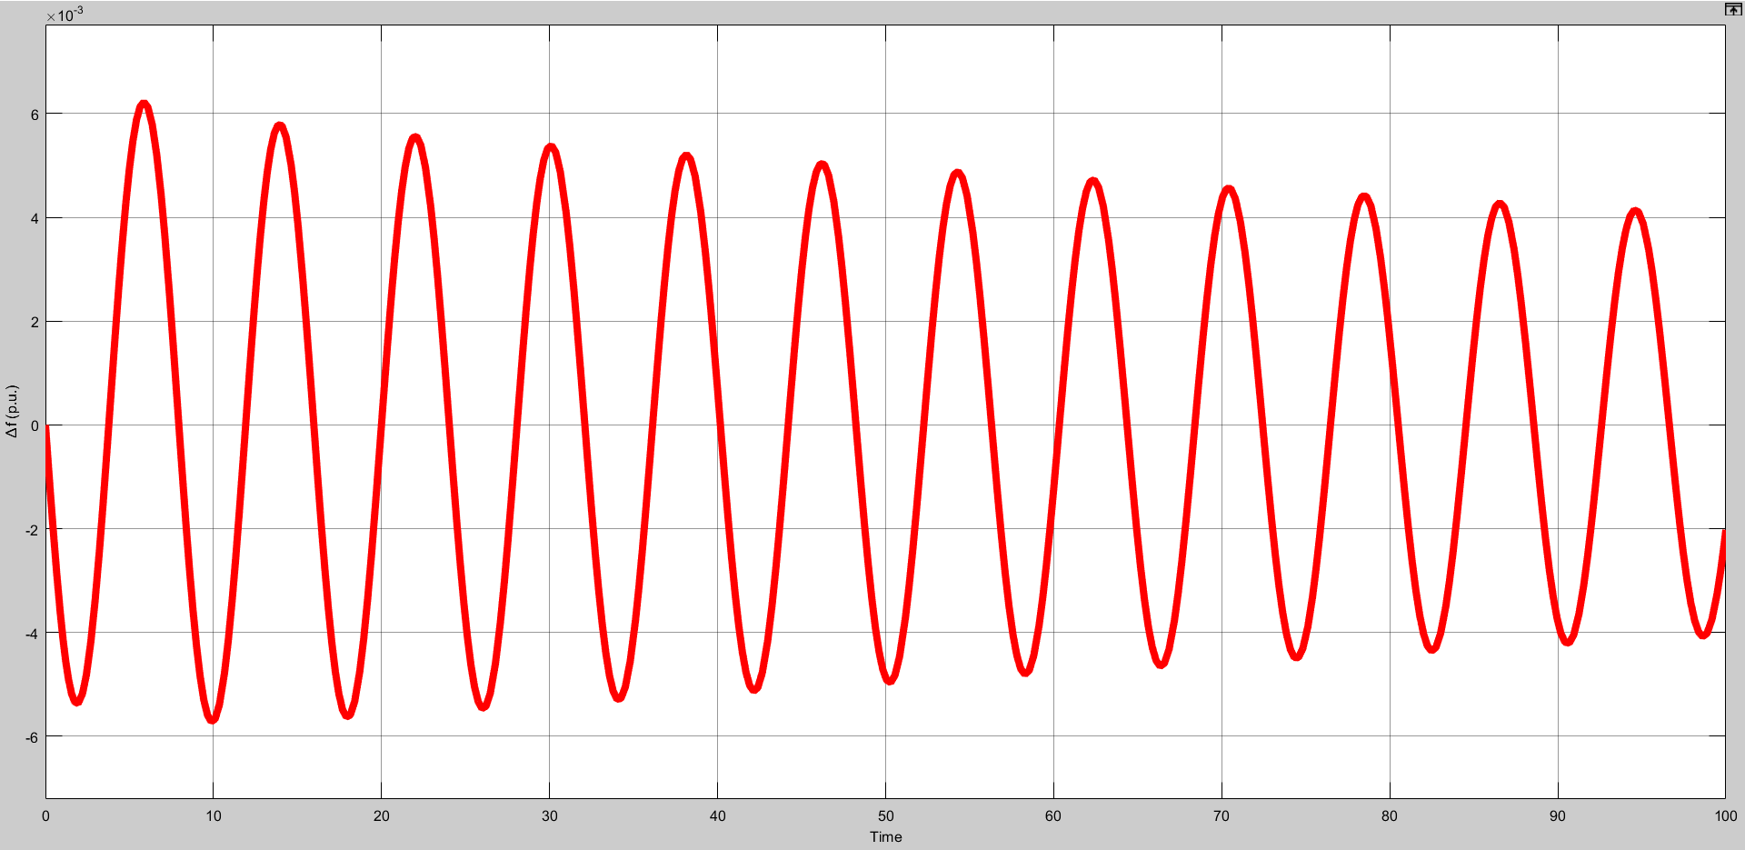
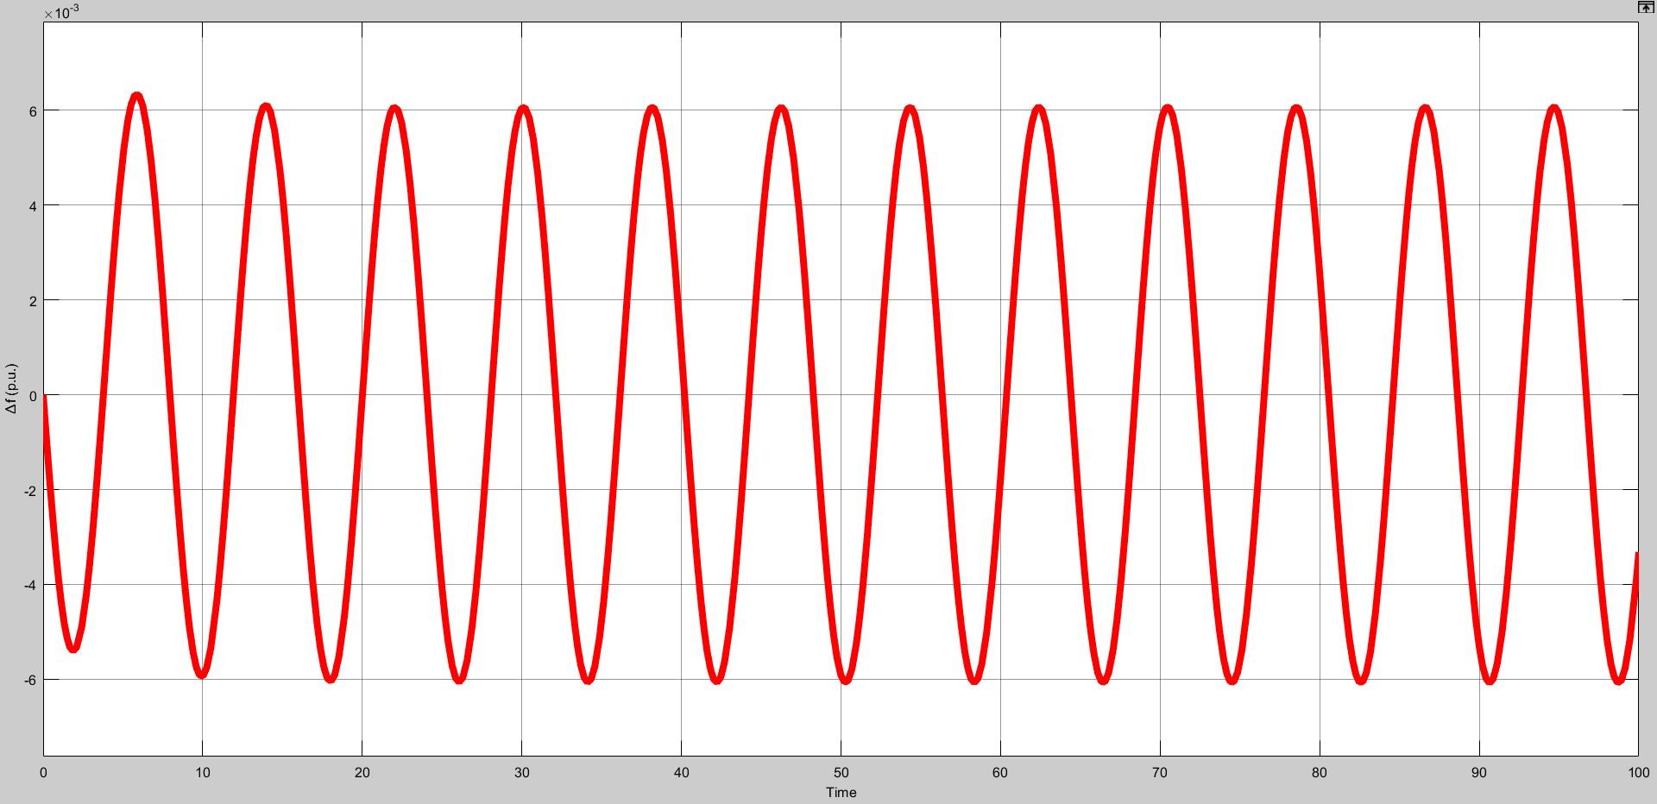
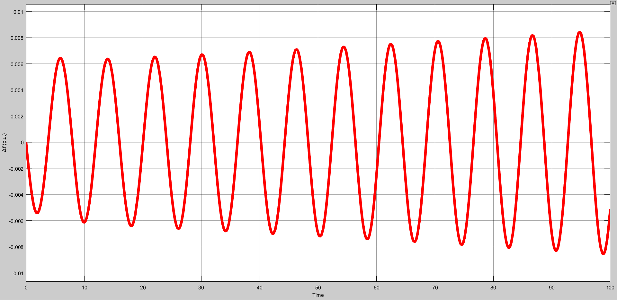
COMPARISON OF FREQUENCY RESPONSE OF LFC-EV SYSTEM FOR DIFFERENT TIME DELAYS: For K_{p}=0.2 , K_{i} =0.6.
τ*= 0.575 sec
(Stable response)
τ*= 0.6018 sec
(Marginal stable response)
τ*= 0.625 sec
(Unstable response)

Slide 30
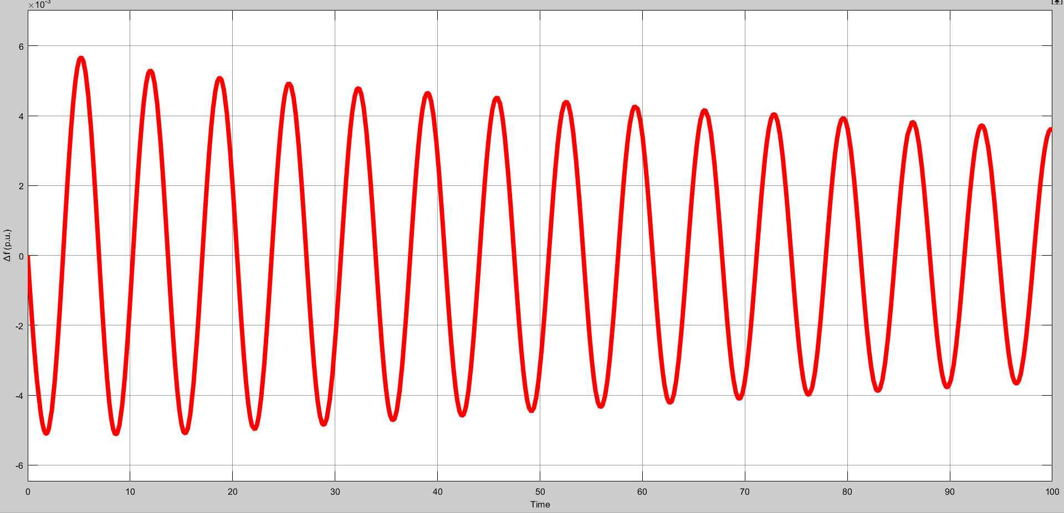
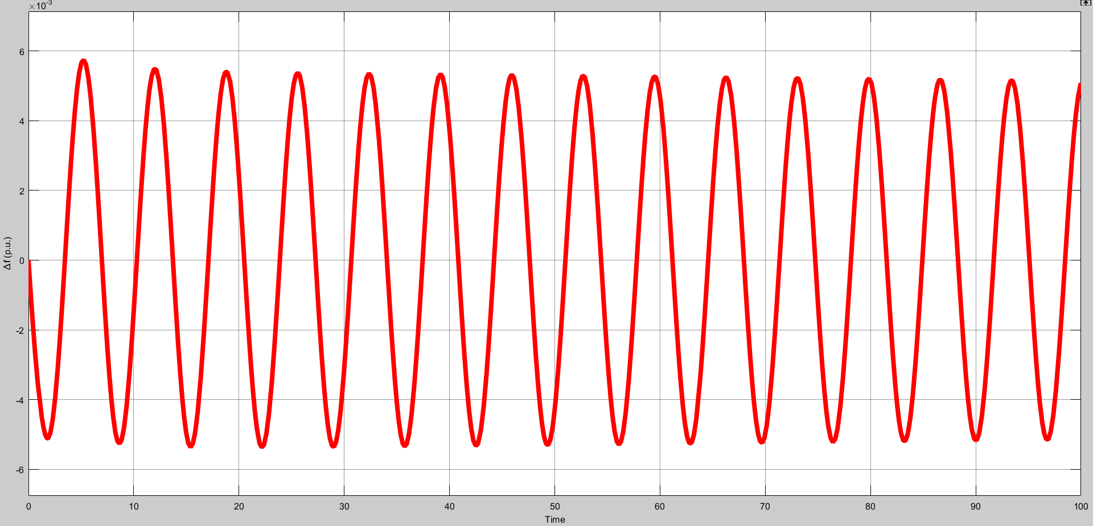
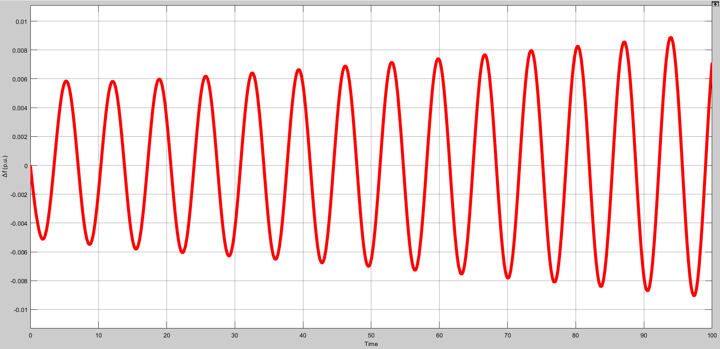
COMPARISON OF FREQUENCY RESPONSE OF LFC-EV SYSTEM FOR DIFFERENT TIME DELAYS: For K_{p}=0.8 , K_{i} =0.6.
τ*=1.475 sec
(Stable response)
τ*= 1.4932 sec
(Marginal stable response)
τ*= 1.525 sec
(Unstable response)

Slide 31
SIMULATION RESULTS: STABILITY REGION CURVE FOR PARTICULAR TIME DELAY AND FOR VARIOUS PARTICIPATION FACTORS.

Slide 32
STABILITY REGION CURVE FOR TIME DELAY=0.5s FOR VARIOUS PARTICIPATION FACTORS:
Blue- α₀=0.7, α₁=0.3
Orange- α₀=0.8, α₁=0.2
Green- α₀=0.9, α₁=0.1
Brown- α₀=1.0, α₁=0

Slide 33
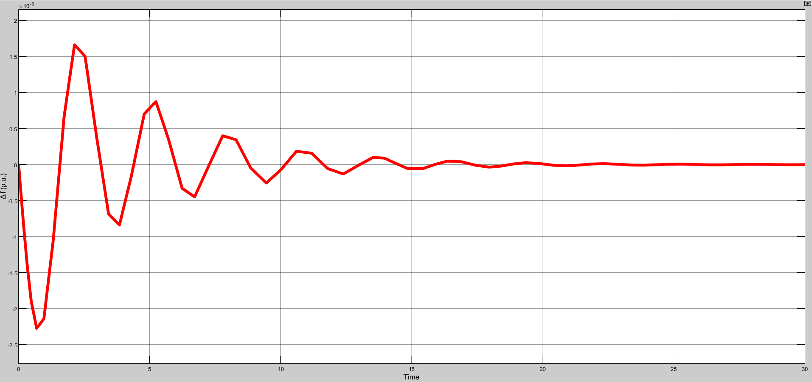
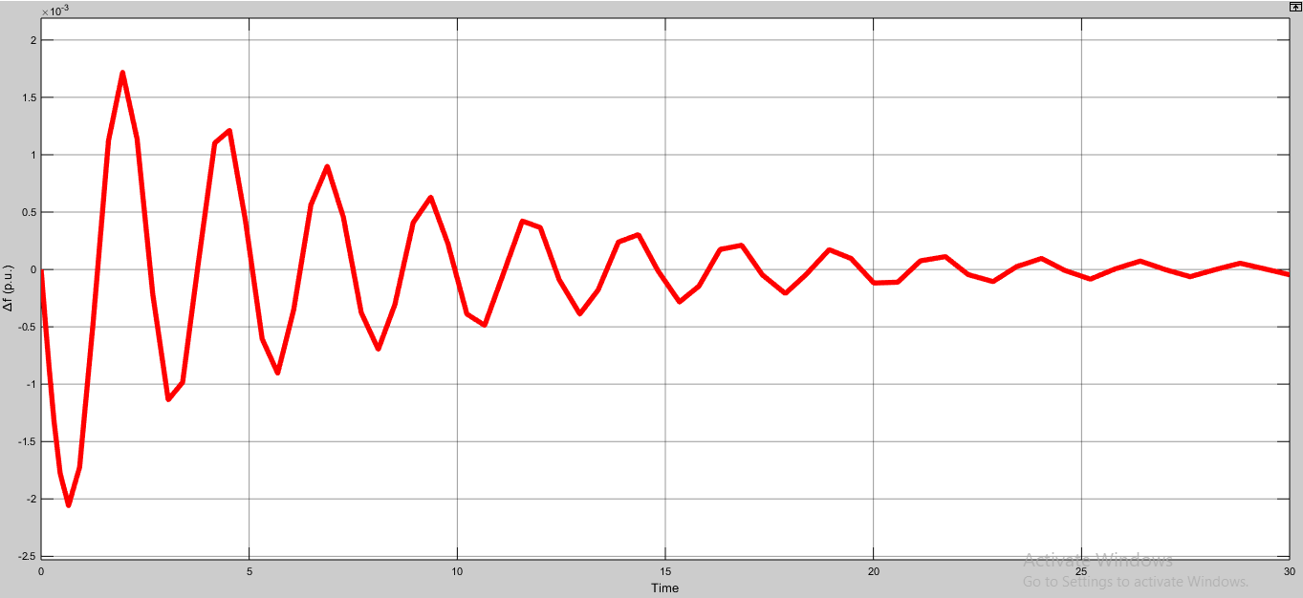
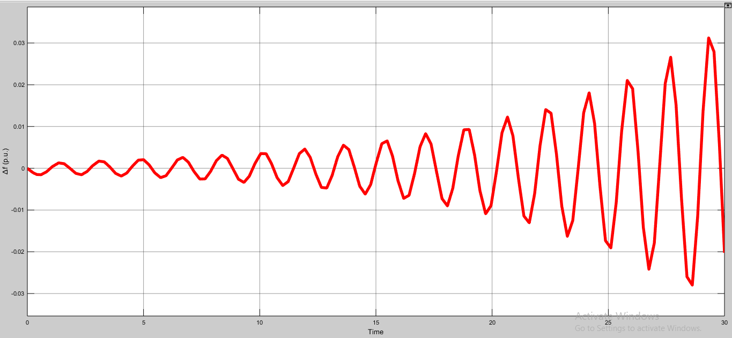
COMPARISON OF FREQUENCY RESPONSE OF LFC-EV SYSTEM FOR DIFFERENT PI PARAMETERS: For Time delay=0.5s , α₀=1 , α₁=0
K_{p}=6 K_{i}=4
(Stable response)
K_{p}=8 K_{i}=5.4
(Marginal stable response)
K_{p}=16 K_{i}=6
(Unstable response)

Slide 34
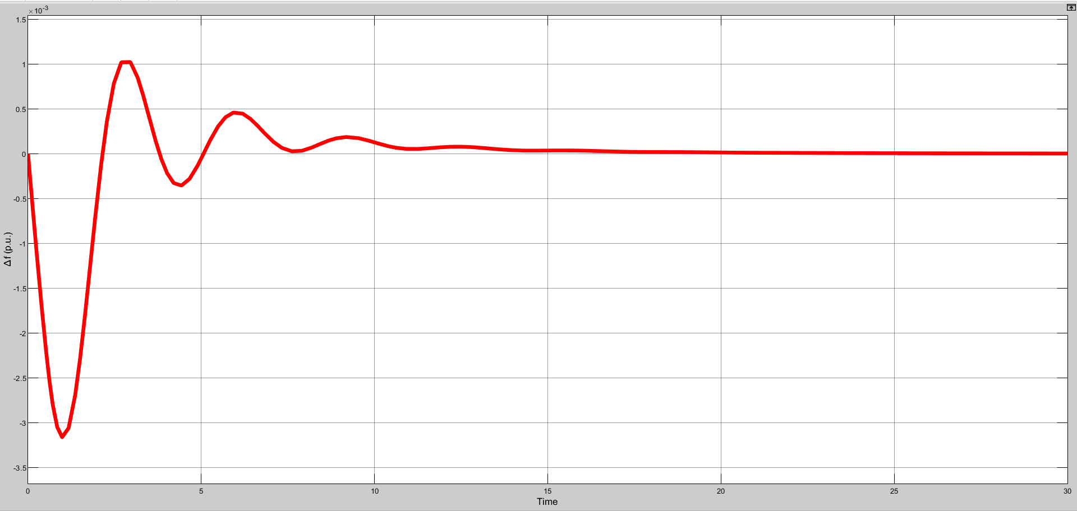
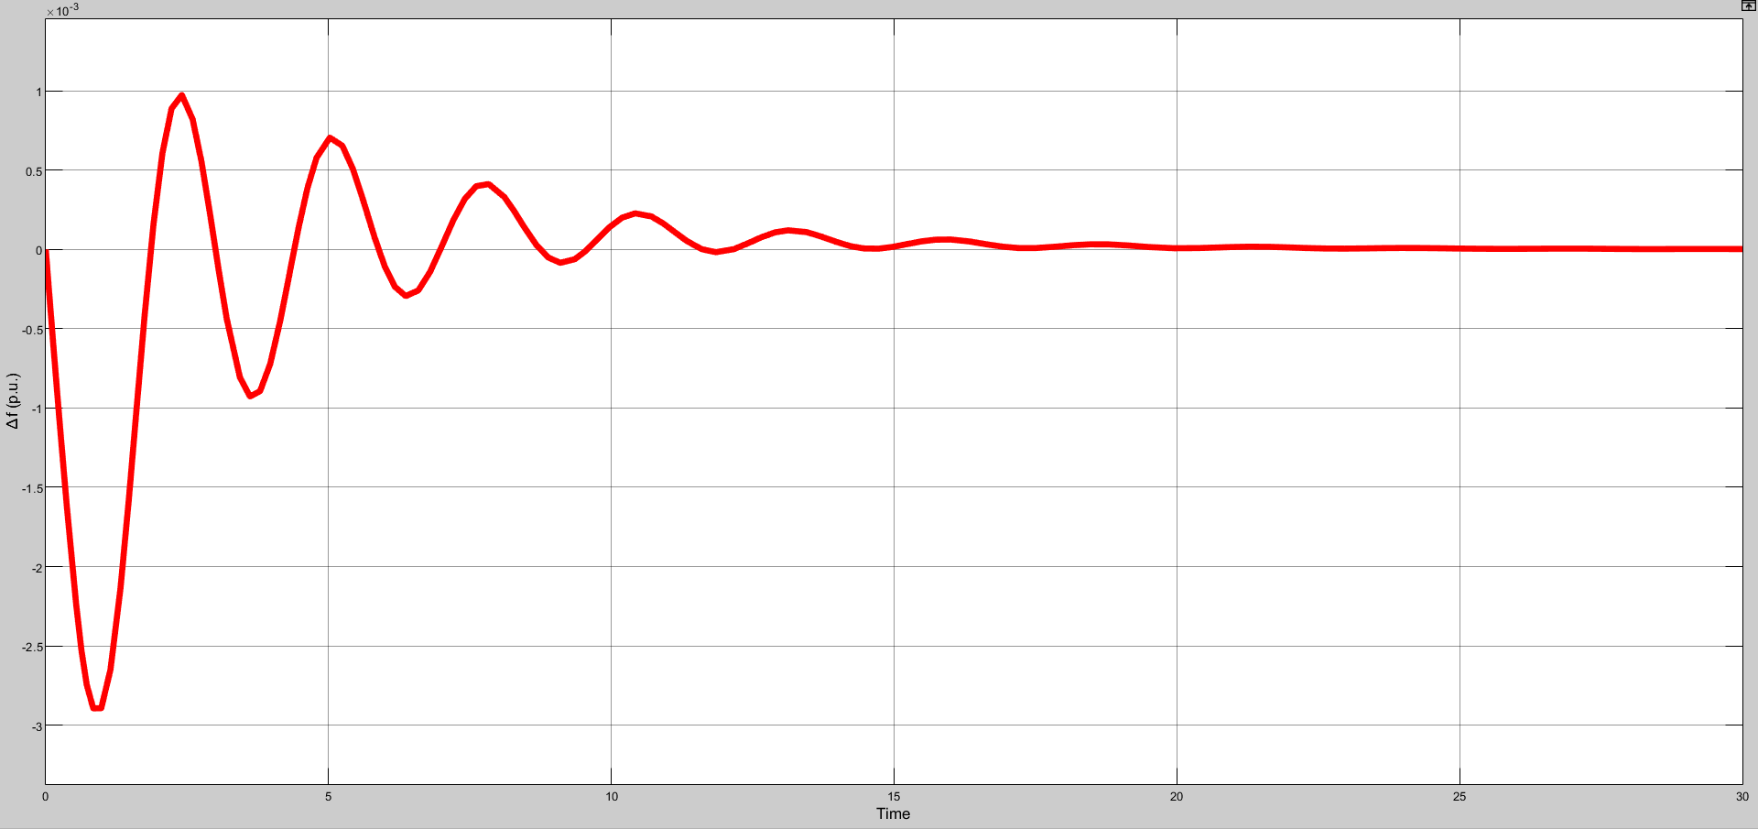
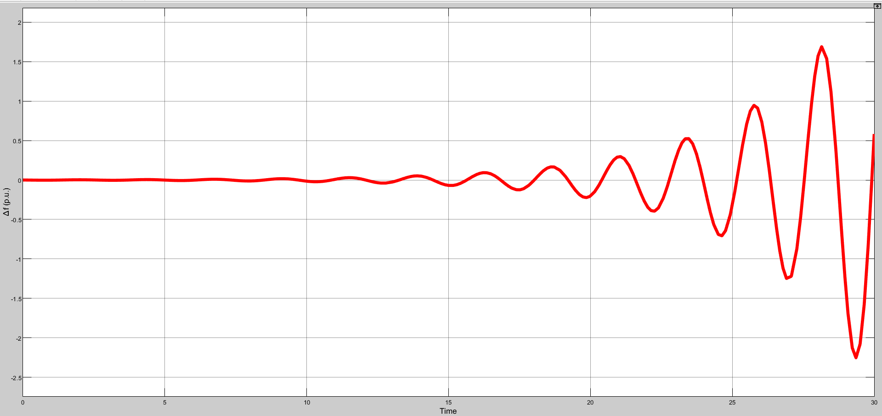
COMPARISON OF FREQUENCY RESPONSE OF LFC-EV SYSTEM FOR DIFFERENT PI PARAMETERS: For Time delay=0.5s , α₀=0.8 , α₁=0.2
K_{p}=2 K_{i}=1
(Stable response)
K_{p}=2.7 K_{i}=1
(Marginal stable response)
K_{p}=4 K_{i}=3
(Unstable response)

Slide 35
COMPARISON OF FREQUENCY RESPONSE OF LFC-EV SYSTEM FOR DIFFERENT PI PARAMETERS: For Time delay=0.5s , α₀=1 , α₁=0
K_{p}=6 K_{i}=4
(Stable response)
K_{p}=8 K_{i}=5.4
(Marginal stable response)
K_{p}=16 K_{i}=6
(Unstable response)

Slide 36
CONCLUSION:
In this project a single area LFC system integrated with EV aggregator over a communication network is considered for stability analysis.
The closed-loop transfer function of the LFC system with EV aggregator and network induced time delay is derived.
The delay-dependent stability analysis is done to compute the stable delay margin for various sub-set of the PI controller parameters.
The delay-dependent stabilization problem is done to compute a feasible region in PI controller parametric space for a known network delay.
The time domain simulation studies are done to validate the analytical results.

Slide 37
BASE PAPER AND REFERENCES:
Ausnain Naveed, Sahin Sonmez and Saffet Ayasun, ‘Impact of Electric Vehicle Aggregator with Communication Time Delay on Stability Regions and Stability Delay Margins in Load Frequency Control System,’ Journal of Modern Power Systems and Clean Energy, In Press. DOI: 10.35833/MPCE.2019.000244, 2020, Springer. (BASE PAPER)
Hakan Gunduz, Sahin Sonmez and Saffet Ayasun, ‘Impact of Electric Vehicles Aggregator on the Stability Region Micro-Grid System with Communication Time Delay,’ 2019 IEEE Milan Power Tech.
Vijay P. Singh, Nand Kishor, and Paulson Samuel, ‘Communication Time Delay Estimation for Load Frequency Control in Two Area Power Systems,’ Ad Hoc Networks, Vol. 41, No. 1, pp. 69-85, May 2016.
Ausnain Naveed, Sahin Sonmez and Saffet Ayasun, ‘Stability Regions in the Parameter Space for LFC System with EV Aggregator and Incommensurate Time Delays,’ 1st IEEE Global Power Energy and Communication Conference (GPECOM 2019), June 12-15, 2019, Cappadocia, Turkey.
Han, Y., Zhang, K., Hong, L., Coelho, E. A. A., and Guerrero, J. M, ‘MAS-based Distributed Coordinated Control and Optimization in Microgrid and Microgrid Clusters: A Comprehensive Overview.’ IEEE Transactions on Power Electronics, Vol. 33, No. 8, pp. 6488-6508, 2018.

Slide 38
6) H. Luo, I. A. Hiskens and Z. Hu, ‘Stability Analysis of Load Frequency Control Systems With Sampling and Transmission Delay,’ IEEE Transactions on Power Systems, Vol. 35, No. 5, pp. 3603-3615, Sept. 2020
7) K. S. Ko and D. K. Sung, ‘The Effect of EV Aggregators With Time-Varying Delays on the Stability of a Load Frequency Control System,’ IEEE Transactions on Power Systems, Vol. 33, No. 1, pp. 669-680, Jan. 2018
8) Deniz Katipoglu, Sahin Sonmez and Saffet Ayasun, ‘Stability Delay Margin Computation of Load Frequency Control System with Demand Response,’ 1st IEEE Global Power Energy and Communication Conference (GPECOM 2019), June 12-15, 2019, Cappadocia, Turkey.

Slide 39
THANK YOU!!!

